Slide 1

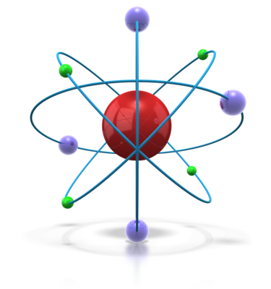

8. ELECTRICITY

Slide 2
8.01 ELECTRIC CHARGE(1)
Electric charge, or 'electricity', can come from batteries and generators.
But some materials become charged when they are rubbed.
Their charge is sometimes called electrostatic charge or 'static electricity'.
It causes sparks and crackles when you take off a pullover and if you slide out of a car seat and touch the door, it may even give you a shock.

Slide 3
Negative and Positive charge
Polythene and Perspex can be charged by rubbing them with a dry, woollen cloth.
When two charged polythene rods are brought close together, as shown below, they repel (try to push each other apart).
The same thing happens with two charged Perspex rods. However, a charged polythene rod and a charged Perspex rod attract each other. Experiments like this suggest that there are two different and opposite types of electric charge. These are called positive (+) charge and negative (-) charge:
Like charges repel; unlike charges attract.
The closer the charges, the greater the force between them.

Slide 4
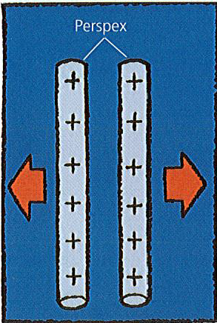
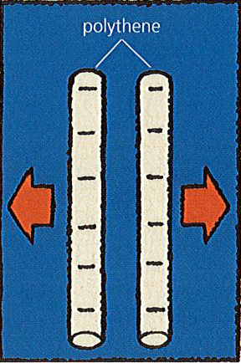
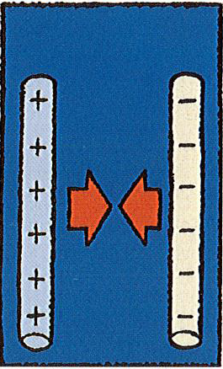

Slide 5
Where do charges come from
Everything is made of tiny particles called atoms. These have electric charges inside them. A simple model of the atom is shown below.
There is a central nucleus made up of protons and neutrons. Orbiting the nucleus are much lighter electrons:
Electrons have a negative (-) charge. Protons have an equal positive (+) charge. Neutrons have no charge.
Normally, atoms have equal numbers of electrons and protons, so the net (overall) charge on a material is zero

Slide 6
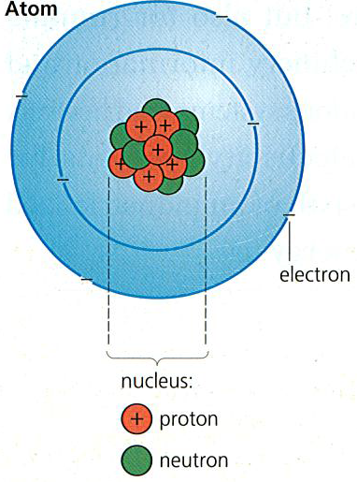
However, when two materials are rubbed together, electrons may be transferred from one to the other. One material ends up with more electrons than normal and the other with less.
So one has a net negative charge, while the other is left with a net positive charge.
Rubbing materials together does not make electric charge. It just separates charges that are already there.

Slide 7
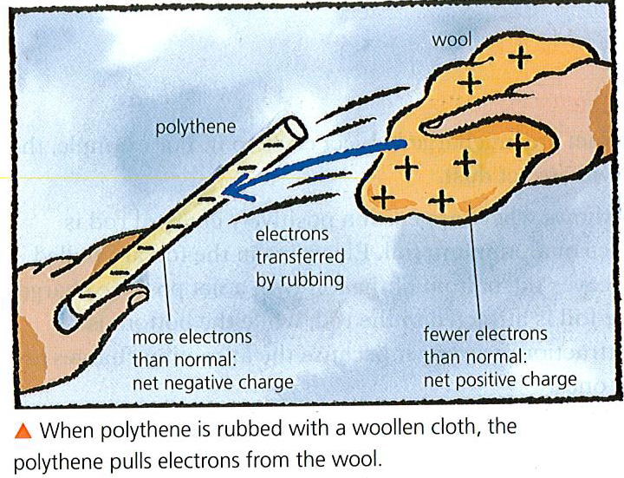
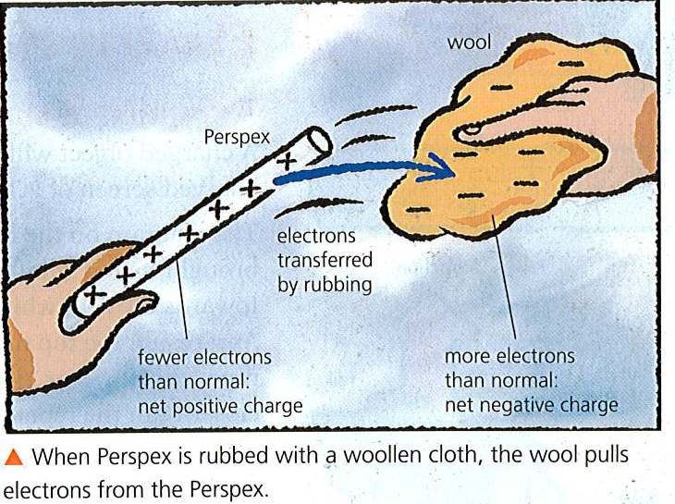

Slide 8
Conductors and Insulators
When some materials gain charge, they lose it almost immediately. This is because electrons flow through them or the surrounding material until the balance of negative and positive charge is restored.
Conductors are materials that let electrons pass through them. Metals are the best electrical conductors. Some of their electrons are so loosely held to their atoms that they can pass freely between them. These free electrons also make alI metals good thermal conductors.
Most non-metals conduct charge poorly or not at all, although carbon is an exception.

Slide 9
Insulators are materials that hardly conduct at all. Their electrons are tightly held to atoms and are not free to move -although they can be transferred by rubbing.
Insulators are easy to charge by rubbing because any electrons that get transferred tend to stay where they are.
Semiconductors * These are 'in-between' materials. They are poor conductors when cold, but much better conductors when warm.

Slide 10
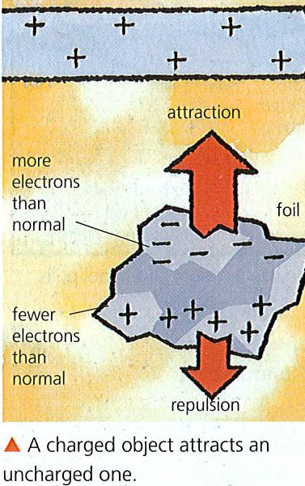
8.02 Electric charge (2)
Attraction of uncharged objects
A charged object will attract any uncharged object close to it. For example, the charged screen of a TV will attract dust.
The diagram on the right shows what happens if a positively charged rod is brought near a small piece of aluminium foil.
Electrons in the foil are pulled towards the rod, which leaves the bottom of the foil with a net positive charge. As a result, the top of the foil is attracted to the rod, while the bottom is repelled. However, the attraction is stronger because the attracting charges are closer than the repelling ones.

Slide 11

Earthing
If enough charge builds up on something, electrons may be pulled through the air and cause sparks - which can be dangerous.
To prevent charge building up, objects can be earthed: they can be connected to the ground by a conducting material so that the unwanted charge flows away.

Slide 12
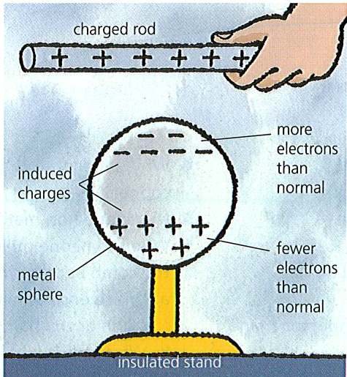
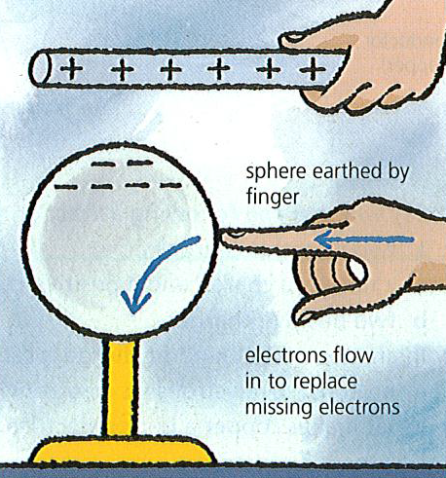
Induced charges
Charges that appear on uncharged object because of a charged object nearby are called induced charges.
In the ,diagram below, a metal sphere is being charged by induction.
The sphere ends up with an opposite charge to that on the rod, which never actually touches the sphere.

Slide 13
Unit of charge
The SI unit of charge is the coulomb (C). It is equal to the charge on about 6 million million million electrons, although it is not defined in this way.
One coulomb is a relatively large quantity of charge, and it is often more convenient to measure charge in microcoulombs :
1 microcoulomb (µC)= 0.000001 C (one millionth of a coulomb)

Slide 14
8.03 Electric field
This is an area around a charged particle(body) where electric effect(attraction/repulsion) is felt.
Direction of electric field is from positive charge towards negative charge. Arrows are used to show the direction.

Slide 15
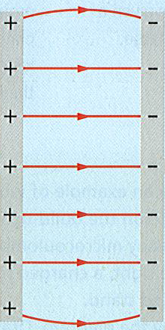
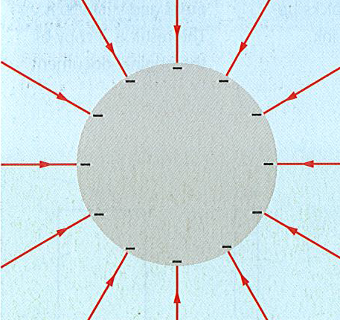
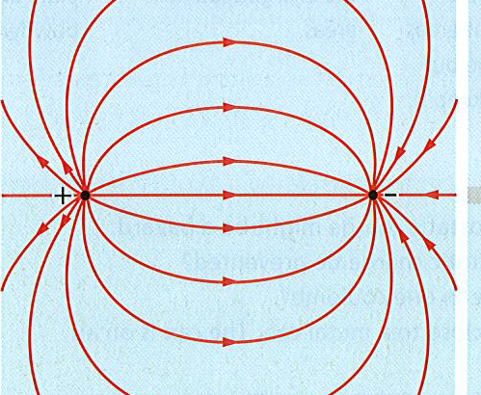
Electric field pattern
Electric field patterns show the direction in which a force acts on a positive charge when placed in an electric field. Figures below show the electric field patterns

Slide 16
8.04 Current in a simple circuit
An electric cell (commonly called a battery) can make electrons move, but only if there is a conductor connecting its two terminals. Then, chemical reactions inside the cell push electrons from the negative (-) terminal round to the positive (+) terminal.
The cell below is being used to light a bulb. As electrons flow through the bulb, they make a filament (thin wire) heat up so that it glows. The conducting path through the bulb, wires, switch, and battery is called a circuit. There must be a complete circuit for the electrons to flow. Turning the switch OFF breaks the circuit and stops the flow.

Slide 17
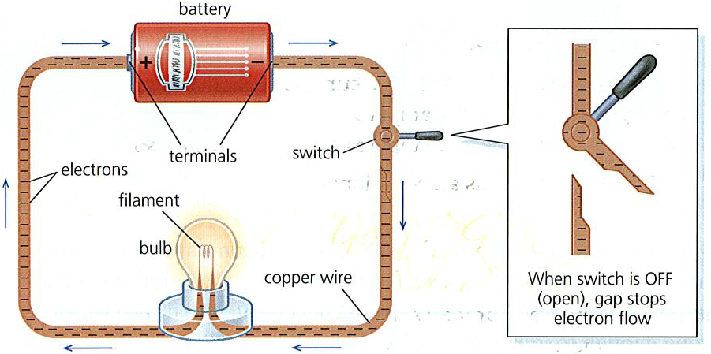
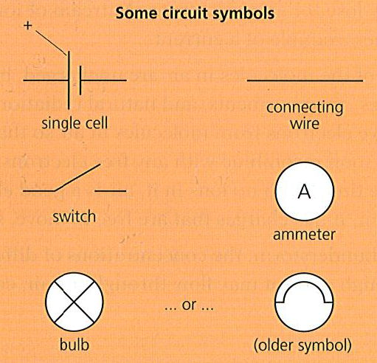
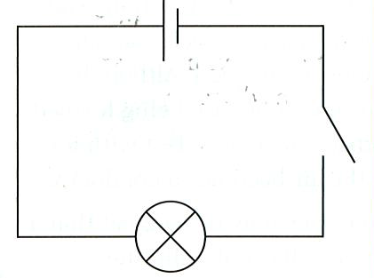

Slide 18
Measuring current
A flow of charge is called an electric current. The higher the current, the greater the flow of charge.
The SI unit of current is the ampere (A).
Currents of about an ampere or so can be measured by connecting an ammeter into the circuit. For smaller currents, a milliammeter is used. The unit in this case is the milliampere (mA). 1000 mA = 1 A
Putting ammeters (or milliammeters) into a circuit has almost no effect on the current. As far as the circuit is concerned, the meters act just like pieces of connecting wire.

Slide 19
Charge and current
There is a link between charge and current: If charge flows at this rate………then the current is...
1 coulomb per second…………….. 1 ampere
2 coulombs per second…………… 2 ampere
...and so on. The link can also be expressed as an equation:
charge = current x time
(C) (A) (s)
For example, if a current of 2 amperes flows for 3 seconds, the charge delivered is 6 coulombs.

Slide 20
Current direction
Some circuit diagrams have arrowheads marked on them. These show the conventional current direction: the direction from + to - round the circuit.
Electrons actually flow the other way. Being negatively charged, they are repelled by negative charge, so are pushed out of the negative terminal of the battery.
The conventional current direction is equivalent to the direction of transfer of positive charge.

Slide 21
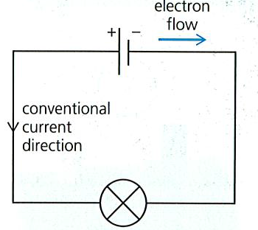
Positive charges do not move although a transfer of positive charge is the same as a transfer of negative charge in the opposite direction.

Slide 22
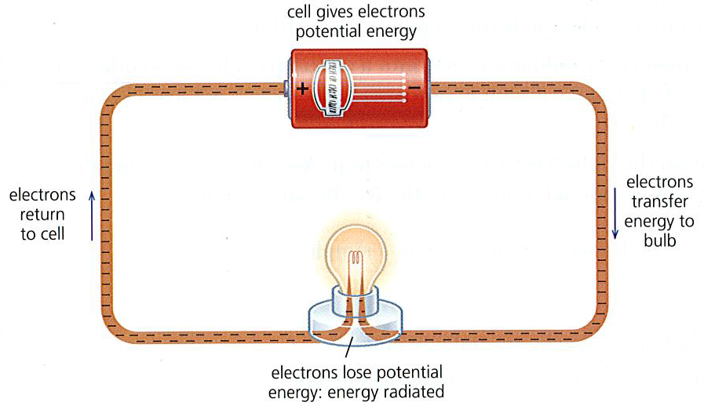
8.05 Potential difference
The cell above is pushing out electrons. The electrons repel each other, so, like the coils of a compressed spring, they have potential energy. As the electrons slowly flow round the circuit, they transfer energy from the cell to the bulb.
The energy is radiated by the hot filament.

Slide 23
PD(voltage) across a cell
A cell normally has a voltage marked on it. The higher its voltage, the more energy it gives to the electrons pushed out. The scientific name for voltage is potential difference (PD). PD can be measured by connecting a voltmeter across the terminals of the cell. The SI unit of PD is the volt (V):
If the PD across a cell is 1volt, then 1 joule of potential energy is given to each coulomb of charge. In other words, 1 volt means 1 joule per coulomb (J/C).
If the PD across a cell is 2 volts, then 2 joule s of potential energy are given to each coulomb of charge, ... and so on.

Slide 24
A cell produces its highest PD when not in a circuit and not supplying current. This maximum PD is called the electromotive force (EMF) of the cell. When a current is being supplied, the PD drops because of energy wastage inside
the cell. For example, a car battery labelled '12 V' might only deliver 9 V when being used to turn a starter motor.

Slide 25
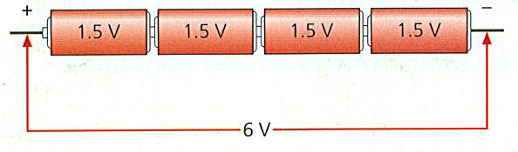
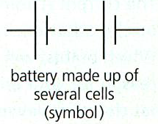
Cells in series
To produce a higher PD, several cells can be connected in series (in line) as shown below. The word 'battery' really means a collection of joined cells.

Slide 26
PDs around a circuit
In the circuit below, the electrons flow through two bulbs. They lose some of their potential energy in the first bulb and the rest in the second. In total, all the energy supplied by the battery is radiated by the bulbs. Almost none is spent in the connecting wires.
Like the battery, each bulb has a PD across it:
If a bulb (or other component) has a PD of 1 volt across it, then 1 joule of potential energy is spent by each Coulomb of charge passing through it.
The second diagram shows the same circuit with voltmeters connected across different sections (the voltmeters do not affect how the circuit works).

Slide 27
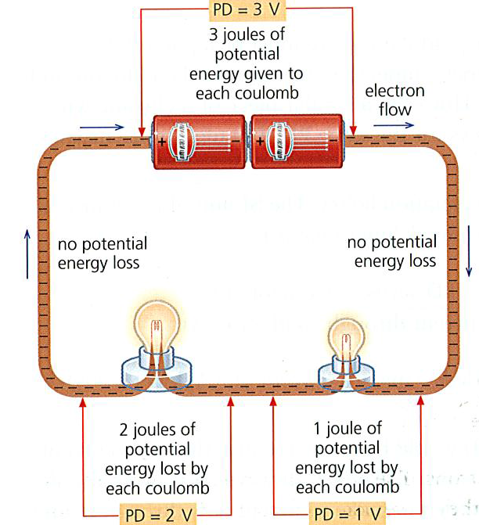
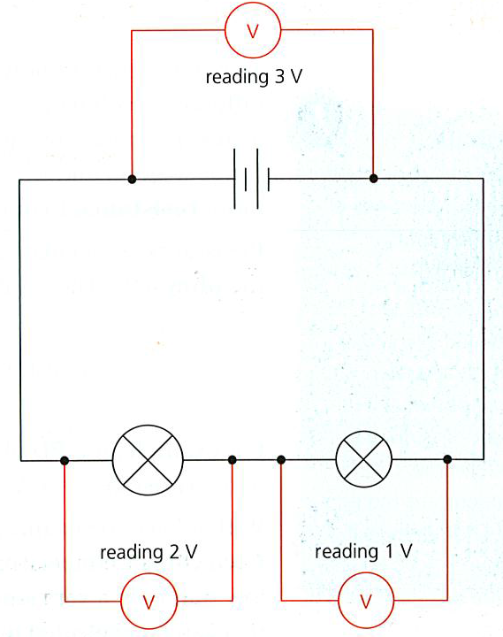
The readings illustrate a principle which applies in any circuit:
Moving round a circuit, from one battery terminal to the other, the sum of the PDs across the components is equal to the PD across the battery.

Slide 28

8.06 Resistance (1)
To make a current flow through a conductor, there must be a potential difference (voltage) across it. Copper connecting wire is a good conductor and a current passes through it easily. However a similar piece of nichrome wire is not so good and less current flows for the same PD.
The nichrome wire has more resistance than the copper wire.
Resistance is calculated using the equation below. The SI unit of resistance is the ohm (Ω). (The symbol Ω is the Greek letter omega.)

Slide 29
For example, if a PD of 6 V is needed to make a current of 3 A flow through a wire: resistance = 6 V/ 3 A = 2 0Ω.
With a lower resistance, a lower PD would be needed to give the same current.
In symbols, the formula for resistance is:
R= V/I
where V is the voltage or PD in volts (v)
I is current in amperes (A)
R is resistance in ohms (Ω)
1 Ω = 1v/A

Slide 30
Factors affecting resistance
The resistance of a conductor depends on several factors:
Length Doubling the length of a wire doubles its resistance.
Cross-sectional area Halving the 'end on' area of a wire doubles its resistance. So a thin wire has more resistance than a thick one.
Material A nichrome wire has more resistance than a copper wire of the same size.
Temperature For metal conductors, resistance increases with temperature. For semiconductors, it decreases with temperature.

Slide 31
Resistance and heating effect
There is a heating effect whenever a current flows through a resistance.
This principle is used in heating elements, and also in light bulbs with filaments.
The heating effect occurs because electrons collide with atoms as they pass through a conductor.
The electrons lose energy. The atoms gain energy and vibrate faster.
Faster vibrations mean a higher temperature.

Slide 32
Resistance components
Resistors are specially made to provide resistance. In simple circuits, they reduce the current. In more complicated circuits, such as those in radios, TVs, and computers, they keep currents and PDs at the levels needed for other components (parts) to work properly.
Resistors can have values ranging from a few ohms to several million ohms.
1kilo-ohm(k Ω) = 1000Ω and
1mega-ohm(MΩ)=1000000 Ω
Like all resistances, resistors heat up when a current flows through them. However, if the current is small, the heating effect is slight.

Slide 33
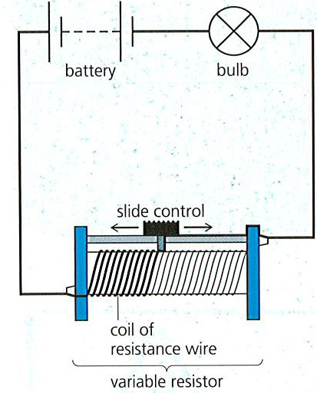
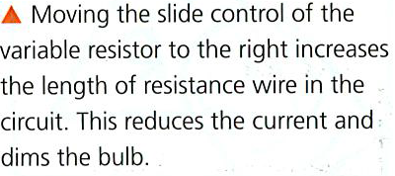
Variable resistors (rheostats) are used for varying current. The one on the right is controlling the brightness of a bulb. In hi-fi equipment, rotary (circular) variable resistors are used as volume controls.
Thermistors have a high resistance when cold but a much lower resistance when hot. They contain semiconductor materials. Some electrical thermometers use a thermistor to detect temperature change.

Slide 34
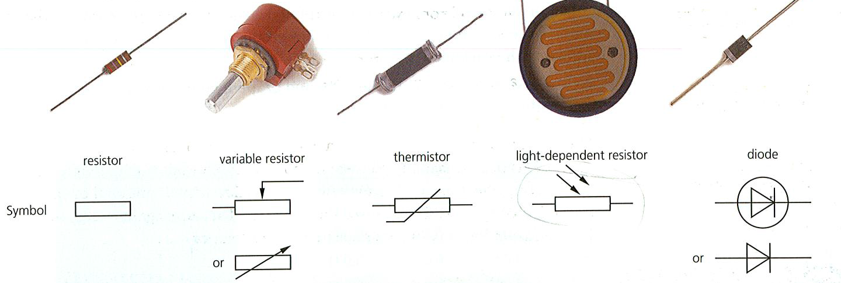
Diodes have an extremely high resistance in one direction but a low resistance in the other. In effect, they allow current to flow in one direction only. They are used in electronic circuits.
Light-dependent resistors (LDRs) have a high resistance in the dark but a low resistance in the light. They can be used in electronic circuits which switch lights on and off automatically.

Slide 35



8.07 Resistance (2)
V, I, R equations
The resistance equation can be written using symbols:
Where R= resistance (Ω),
V= voltage/PD(v), I= current(A)

Slide 36
Examples
A 12Ω resistor has a p.d. of 6v across it. What is the current in the resistor?
I= V/R = 6/12 = 0.5 A
A current of 3A flows through a resistor of resistance 4Ω . What is the voltage across the resistor?
V = IR = 3x4 = 12V
Question A battery of PD 12V supplies a current of 1.5A to a resistor of unkown resistance. Calculate the resistance of the resistor.

Slide 37
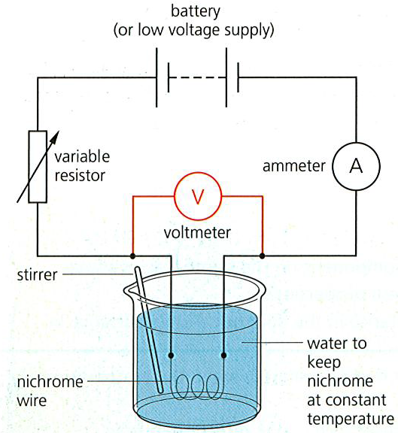
How the current varies with p.d. for a metal conductor
The circuit on the right can be used to investigate how the current through a conductor depends on the PD across it.
The conductor in this case is a coiled-up length of nichrome wire, kept at a steady temperature by immersing it in a large amount of water.
The PD across the nichrome can be varied by adjusting the variable resistor.
Typical results are shown in the table and graph below. The experiment is also one method of measuring resistance.

Slide 38
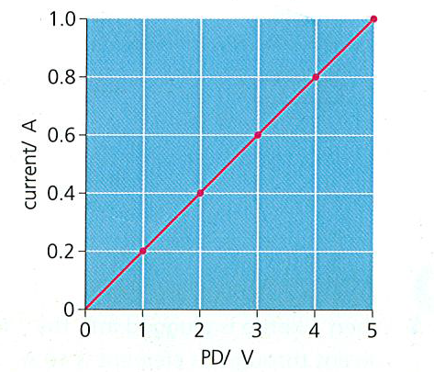
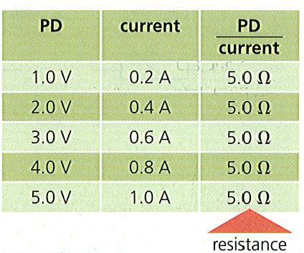

Slide 39
Ohm’s law
The above results have these features:
A graph of current against PD is a straight line through the origin.
If the PD doubles the current doubles,……….and so on.
PD/current always has the same value(5Ω in this case).
This is known as Ohm’s law.
Metal conductors obey Ohm’s law provided their temperature doesn’t change. All conductors obey Ohm’s law provided the temperature remains constant

Slide 40
Tungsten filament and semi-conductor diode don’t obey Ohm’s law as shown in the graphs below:
Teacher to draw on board

Slide 41

Proportionality problems
When there are mathematical problem s to solve, equations are much more useful than proportionalities. Fortunately, the proportionality linking resistance (R), length (l), and area (A) can be converted into an equation like this:

Slide 42
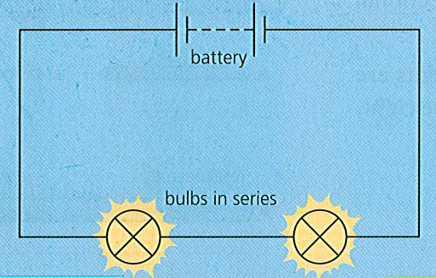
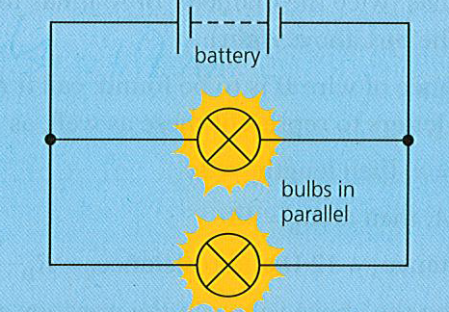
Series and parallel circuits
The lamps are connected in series:
The lamps share the PD(voltage) equally, so each glows dimly.
If one lamp is removed, the others go out because the circuit is broken.
These lamps are connected in parallel.
Each gets the full PD from the battery because each is connected directly to it. So each glows brightly.
If one lamp is removed, the other keeps on working because it is still part of unbroken circuit.

Slide 43
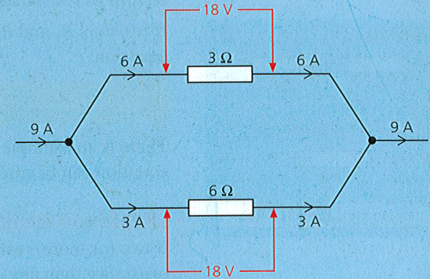
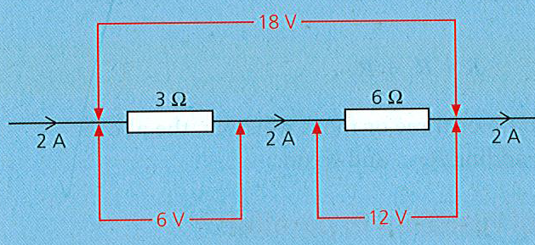
Basic circuit rules
When resistors or other components are in series:
the current through each of the components is the same
j • the total PD (voltage) across all the components is the sum of the PDs across each of them.
When resistors or other components are in series:
the current through each of the components is the same
j • the total PD (voltage) across all the components is the sum of the PDs across each of them.
When resistors or other components are in series:
the current through each of the components is the same
j • the total PD (voltage) across all the components is the sum of the PDs across each of them.
There are some basic rules for all series and parallel circuits. They are illustrated by the examples below. The particular current values depend on the resistances and PDs. However, the equation below always applies to every resistor.
PD = current x resistance
When resistors or other components are in series:
the current in each of the components is the same
The total PD(voltage) across all the components is the sum of of the PD across each of them.
When resistors or other components are in parallel:
The PD across each of the components is the same.
The total current in the main circuit is the sum of the currents in the branches

Slide 44
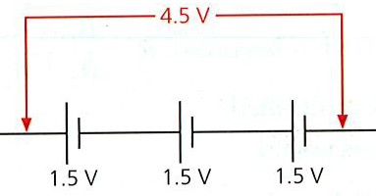
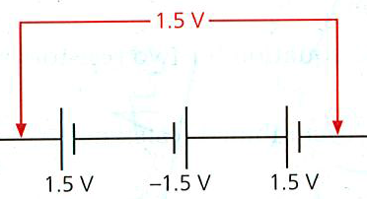
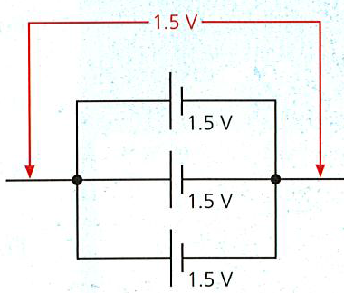
Cell arrangements
These cells are connected in series. The total PD (voltage) across them is the sum of the individual PDs
One of the cells is wrong way round, so it cancels out one of the others
The PD across parallel cells is only the same as from one cell. But together, the cells can deliver a higher current

Slide 45
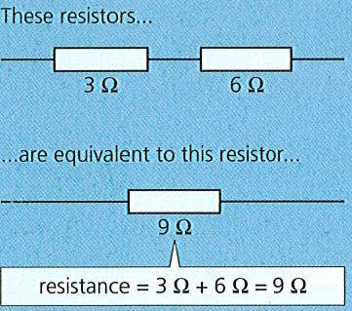

Series and parallel circuits(2)
Combined resistance of resistors in series
If two (or more) resistors are connected in series, they give a higher resistance than any of the resistors by itself. The effect is the same as joining several lengths of resistance wire to form a longer length.
If resistors R1 and R2 are in series, their combined resistance R is given by this equation:

Slide 46



Combined resistance of resistors in parallel
If two (or more) resistors are connected in parallel, they give a lower resistance than any of the resistors by itself. The effect is the same as using a thick piece of resistance wire instead of a thin one. There is a wider conducting path than before.
If two resistors R1 and R2 are in parallel, their combined resistance R is given by this equation
Which leads to
And in words

Slide 47
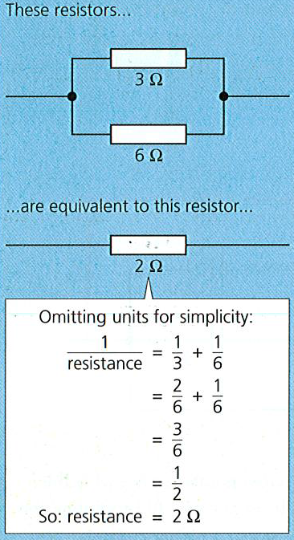
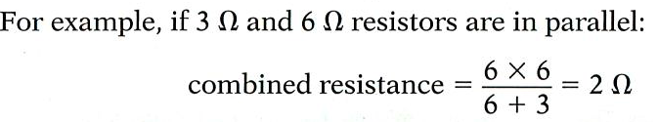
This method of calculation works only for two resistors in parallel

Slide 48
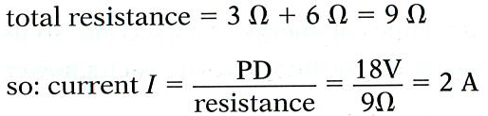
Solving circuit problems
To solve problems about circuits, you need to know the basic circuit rules on the previous spread. You also need to know the link between PD (voltage), current, and resistance. This is given below
The first stage is to calculate the total resistance in the circuit, and then use this information to find the current:
Knowing that the 3 Ω resistor has a current of 2 A in it, you can calculate the PD across it:
V=I*R V=2A*3Ω=6V

Slide 49
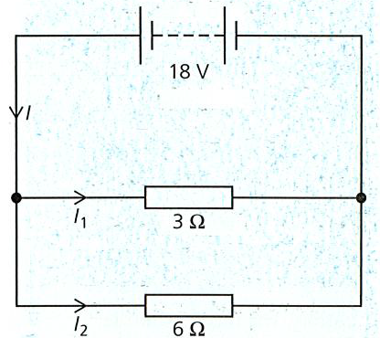

Calculate the currents I , I1, and I2 in the circuit below.
The 3 .0Ω resistor has the full battery PD of 18 V across it , so:
The current I is the total of the currents in the two branches. So:
I = I1 + I2 = 6 A + 3 A = 9 A

Slide 50
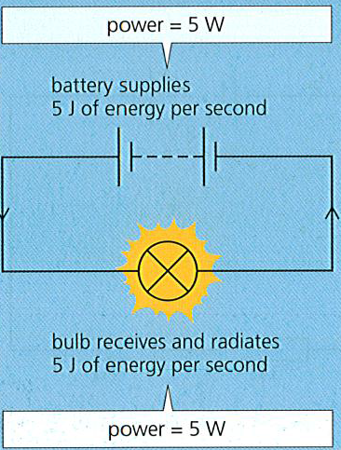

Power is the rate at which energy is transformed (changed from one form to another). The SI unit of power is the watt (W):
The battery on the left is supplying 5 joules of energy every second, so its power is 5 watts. The bulb is taking energy at the same rate, so its power is also 5 watts.

Slide 51


Electrical power equation
For circuits, there is a more useful version of the power equation. If a battery, bulb, or other component has a PD (voltage) across it and a current through it, the power is given by this equation:
In symbols:

Slide 52
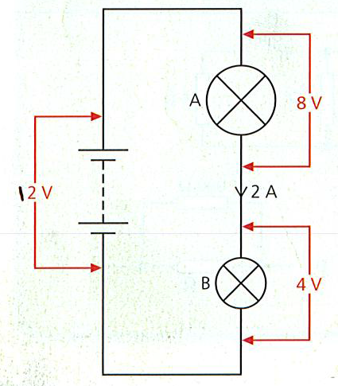
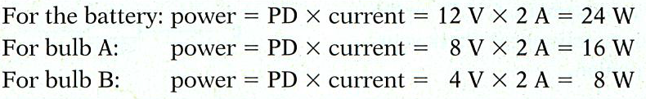

Slide 53



Electrical energy
If the power of an appliance is known, the energy transformed in any given time can be calculated by rearranging the power equation like this:
In an electrical circuit, where PD(voltage), current and time are known, electrical energy is calculated using the equation:
In symbols

Slide 54
Example A 12 V water heater takes a current of 2 A. If it is switched on for 60 seconds, how much thermal energy does it produce?
Energy transformed=PD X current X time
E = V I t
Energy= 12x2x60= 1440 J
Hence thermal energy produced is 1440J

